Slide 1
Secrets Management For Cloud, DevOps & Applications
Notes:
Today I’ll be talking about securing privileged access in the cloud at scale, and managing secrets within the DevOps Continuous Integration and Deployment Pipeline.

Slide 2
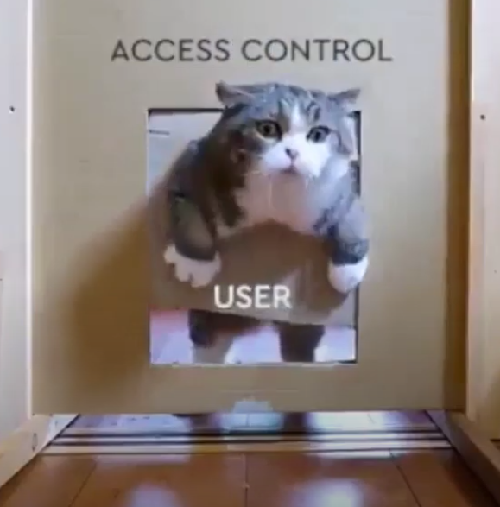

Everybody wants a secure DevOps flow, but…
Developers
Security
Good USER EXPERIENCE IS IMPORTANT!
So is collaboration!
Notes:
Show me the Dev$ecOp$
https://youtu.be/com/EMN47OtIhS0?t=5863

Slide 3

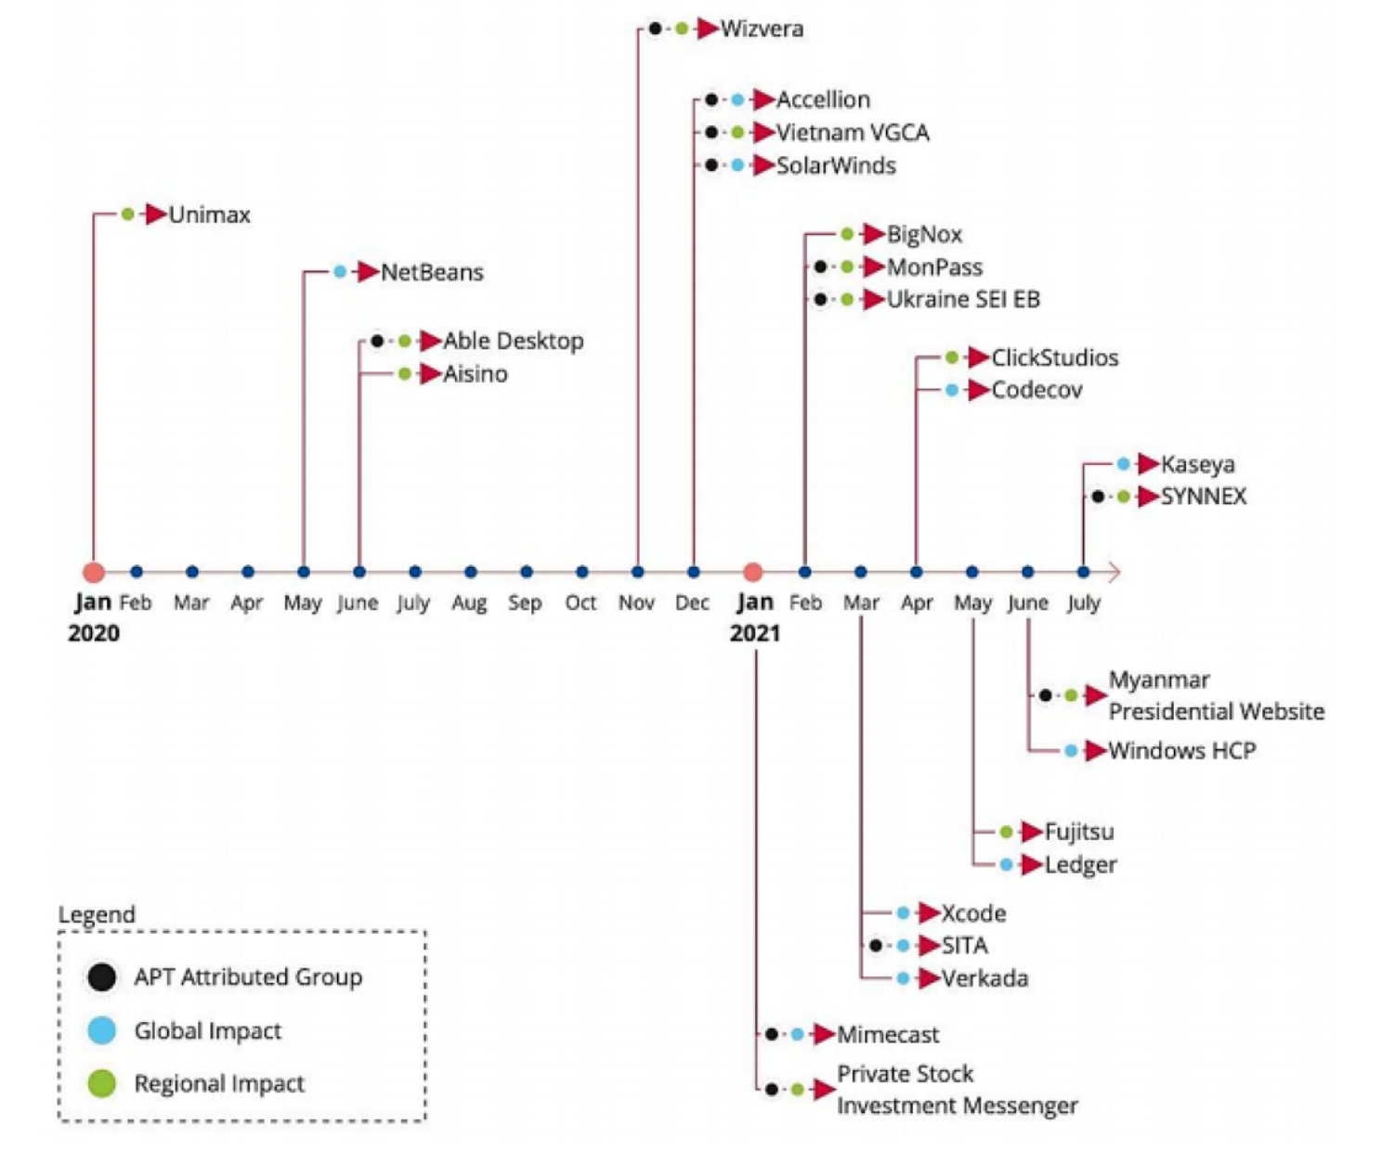

The state of Software Supply Chain Attacks
15%
Of organizations experienced an attack on their software supply chain in 2021
3 times
As many will experience these attacks by 2025
66%
Of attacks in 2020-2021 compromised code
Millions
Of organizations affected
Gartner, How SW engineering leaders can mitigate software… 15 July 2021
ENISA, Threat Landscape of Software Supply Chain attacks, July 2021

Slide 4












Software Supply Chain – The Risks
Exposed Credentials
Code Injection
Malicious Use of Interactive Access
Code Theft
Code Tampering
Compromised OSS
Exposed Credentials
Injected Malware
Stolen Access Keys
Hijacked Compute/Resources
Exposed Data
Stolen IP
Exposed Credentials
Injected Code, Artifacts, Malware
Rogue Scripts
Build
Test/Provision
Run /Operate
Open Source
Git
Code
CI/CD Tools
Artifact Repo
Automation
Containers
Hybrid
Native Cloud
Weak authentication
Authentication fatigue
Lack of credential rotation
Lack of audit
Over-permissioning
Local admin rights
Credential theft risk
High variability of unknown applications
Relaxed security policy
Developer
Identity/Access
Endpoint

Slide 5
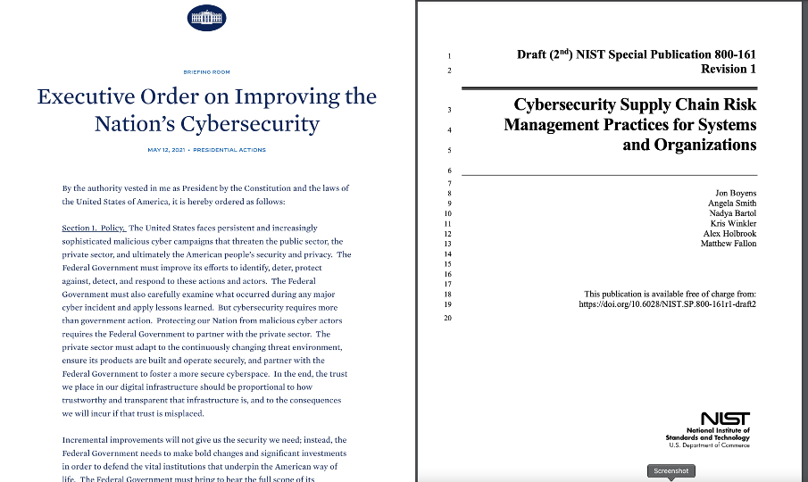
NIST 800-161 Control Mappings
Identification and Authentication
Access Control
Audit and Accountability
Notes:
Before we move on to our use case example, and talk track for CI/CD pipelines, let’s look at the NIST SP 800-53 controls that we will be helping with today.
Access Control:
Provide a way to authenticate and authorize workloads only to the credentials they need while protecting the credential from falling into the hands of humans
Auditing and Accountability
Logging credential retrieval by both humans, as well as non-human identities
Identification and Authentication
Providing the ability to identify and authenticate workloads using modern platforms such as cloud and platform architecture, or using token authentication.

Slide 6
SHIFTING SECURITY LEFT INTO DEVELOPMENT WORKFLOWS
Plan
Code
Operate
Create
Test
Release
Deploy
Enable Developer/DevOps
Easy to use (consume secrets)
Prebuilt integrations
Open source and Secretless
Free developers from security burden
Compliance, audit requests, human creds
Security budget
Empower security team
Highlight the app & tool risk
Leverage single platform – human/non-human solution serves all
Security focus
Manage security budget
Developers
DevOps
Security

Slide 7


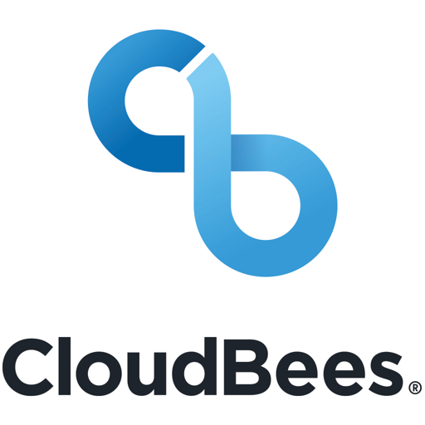






The Problem We’re Solving
There are lots of places to store secrets.
But:
Platform solutions only work for those platforms
Tool solutions lack security
Most not enterprise ready
Hard to share best-practices
SoD not enforced
IGA/GRC reporting is impossible
Heterogeneous Islands of Security
Home Grown Solutions
Secrets
Secrets
Databags
IAM / KMS
IAM / KMS
IAM / KMS

Slide 8
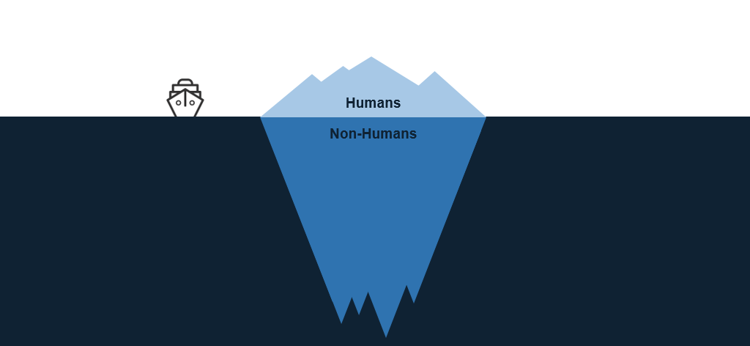
Human Access vs. Non-Human Access

Slide 9






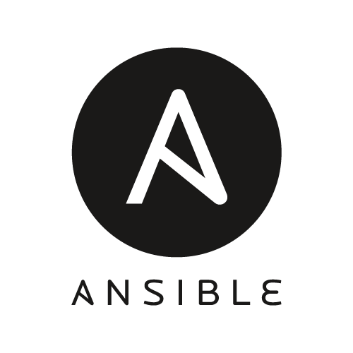




Cyberark secures the entire Supply Chain of Trust
Human Engineers
(Root)
Platform Access
Build/Test
Config/Deploy
Tools & Automation
(Intermediates)
Pre-Prod
Production
Version Control
Test Environments
Artifact Repository
On-Prem
Cloud
Apps & Target Systems
(End Entities)
Target Systems
Target Systems

Slide 10


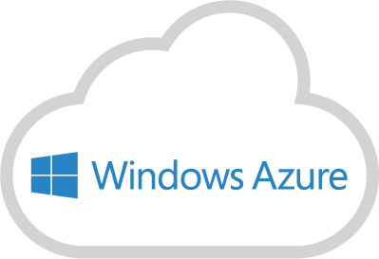

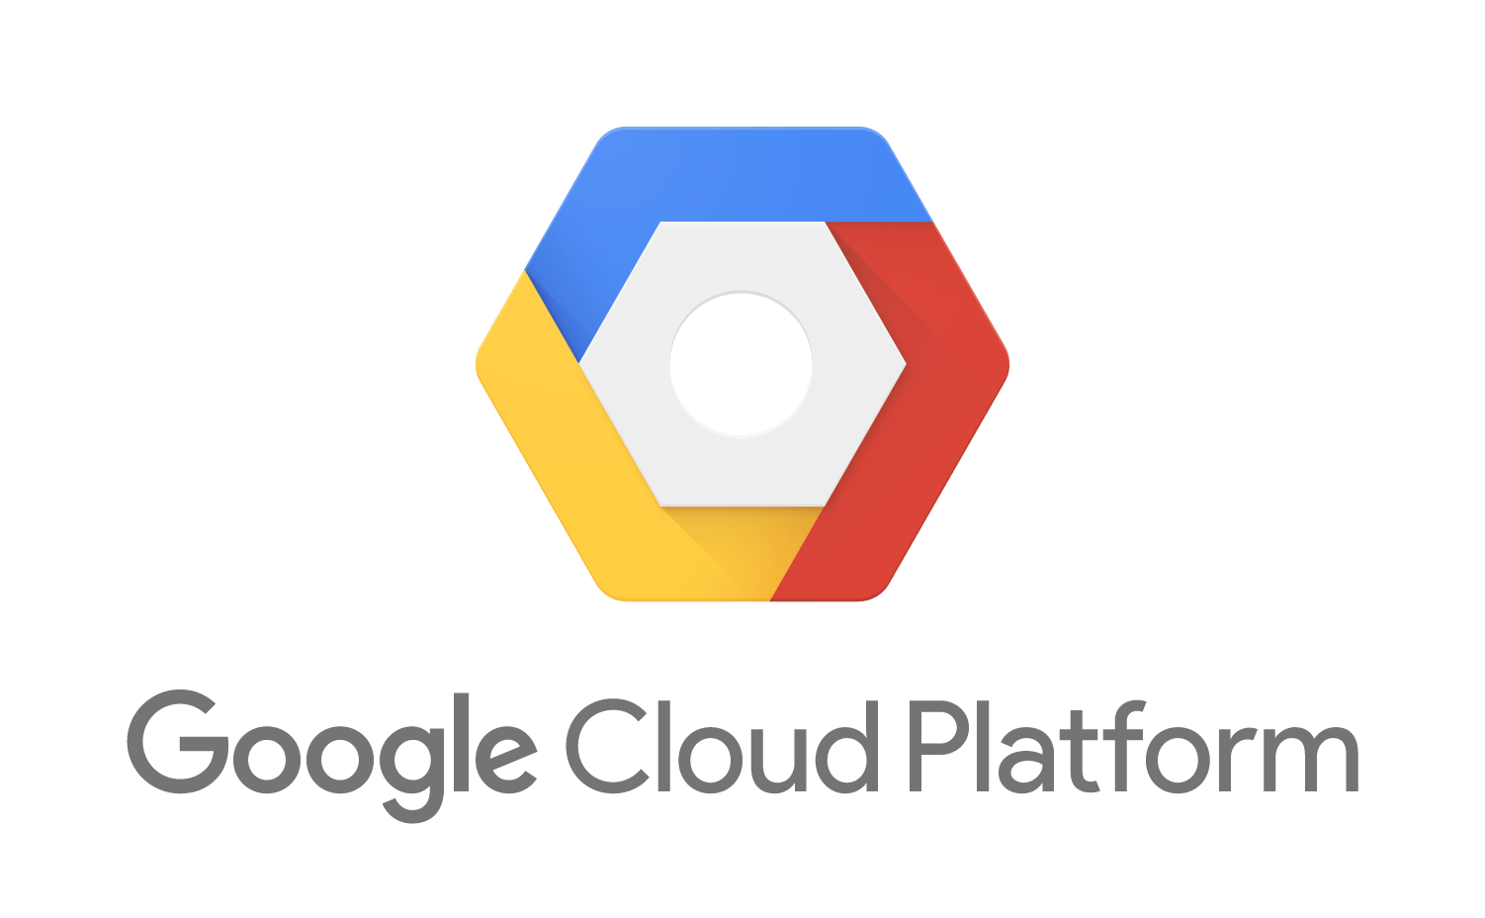
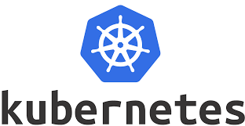







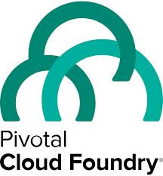
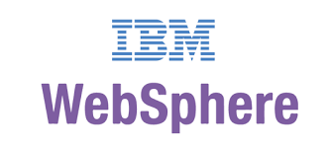







The Vision We’re Delivering On
Consistently enforce privilege security policies for both human users and non-human identities
Enterprise-Spanning Service delivered by IT Security
PAS
On-Prem Infrastructure and Apps
(*NIX, Windows, zOS)
IaaS
PaaS
DevOps Tools
App Servers and Custom Apps
Security
Solutions
IT Mgt
Software
RPA
Notes:
Only CyberArk offers an integrated solution for credentials and secrets management, regardless of the compute or development environment. Using a single control point to enforce consistent privileged security policies across the enterprise is a best practice for CISOs and IT leaders. And it’s something that we’re increasingly hearing from Gartner, Forrester and other analysts.

Slide 11
Secrets Management Solutions

Slide 12









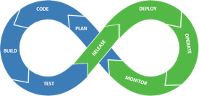
Centralized Audit, Security Policy, & Secrets Rotation
CyberArk
Vault
Consistent, Unified Enterprise-Wide PAS Program
Multi-Persona UI
PVWA
Conjur
CyberArk Secrets Management
Privileged Threat Analytics
CPM
PSM, OPM
Credential Providers
– Agent-based
Credential Providers
– Agentless

Slide 13


CyberArk Secrets Management - Solution Architectures
Agent-Based
Agentless
AWS Secrets Manager
443
app
SDK
app
REST
CP
CP
script
script
CLI
Secrets Hub
REST
Credential Provider
CyberArk
Vault
1858
Central Credential Provider
J2EE App Server
CP
DS
Config
Files
Application Server Credential Provider
app
Conjur Enterprise
CPM Push-to-File

Slide 14
Secrets Hub

Slide 15

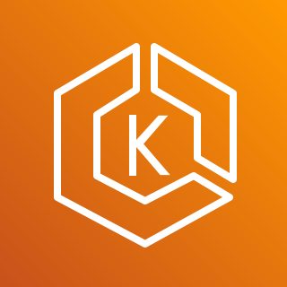

Secrets Hub – Provides separation of concerns
Security
Central Management
Enforce one policy across the organization
Single pane of glass
Unified audit system
Manage
Consume
CyberArk Vault
CyberArk Secrets Hub
AWS Secrets Manager
(System of Record)
(System of Access)
Native cloud experience
No need to write rotators
Secure workloads without impacting workflows
Developers
Services

Slide 16
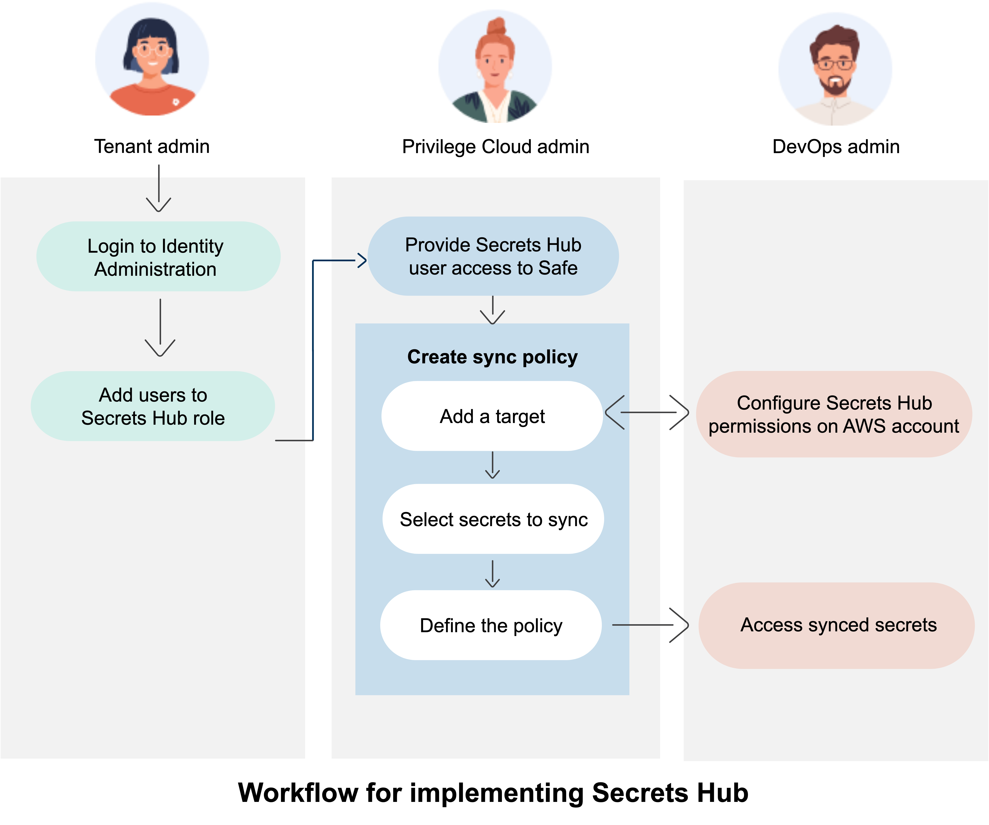
Secrets Hub – Workflow
In PVWA:
Add SecretsHub user to CyberArk Safe
In AWS Cloud Formation:
Add SecretsHub Role to AWS account
Grants SecretsHub access to AWS Secrets Manager (ASM)
In SecretsHub Console:
Create Target object for AWS account
Create Sync policy naming Safe and AWS Account
Changes in Safes are synced to ASM every minute
Rotations
New accounts
Option to create secrets first in ASM
A Deny policy can be applied to to make SecretsHub-managed secrets read-only
AWS Account admin
safes
safes

Slide 17
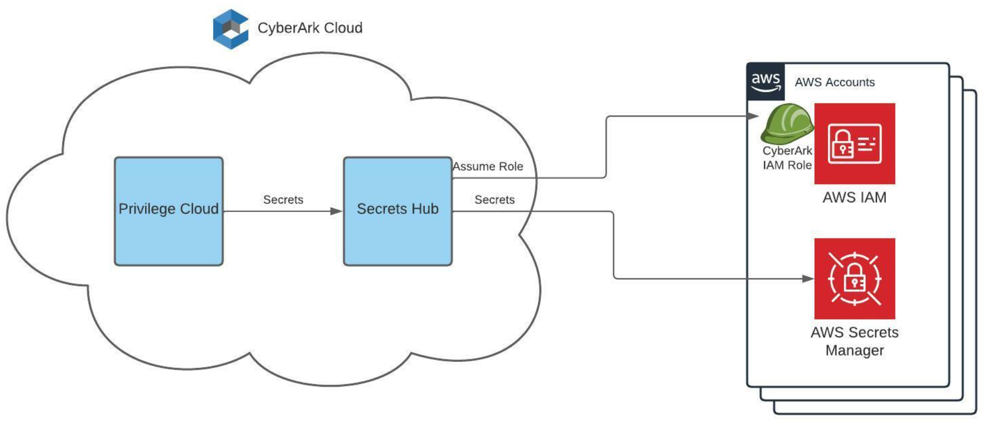
Secrets Hub – Architecture (early access)

Slide 18
Conjur

Slide 19
Conjur Secrets Manager - Solution Architecture
Secrets Updates
Enterprise Vault
(system of record)
Audit Updates
Synchronizer
L
Leader/Standby
(update availability)
S
Followers
(service availability, scalability, accessibility)
F
F
Build Automation
Deployment Automation
Infrastructure Automation
Applications
Applications

Slide 20
Conjur Secrets Manager Architecture – Example
Enterprise Vault
Synchronizer
Leader cluster
DR
S
Async
L
Sync
S
S
LB w/ Health check
Cloud Region
On-Prem
OpenShift
/ K8s
F
F
F
F
F
F
LB
LB
LB
CI-CD Tools / Applications
CI-CD Tools / Applications
CI-CD Tools / Applications

Slide 21
Authentication

Slide 22

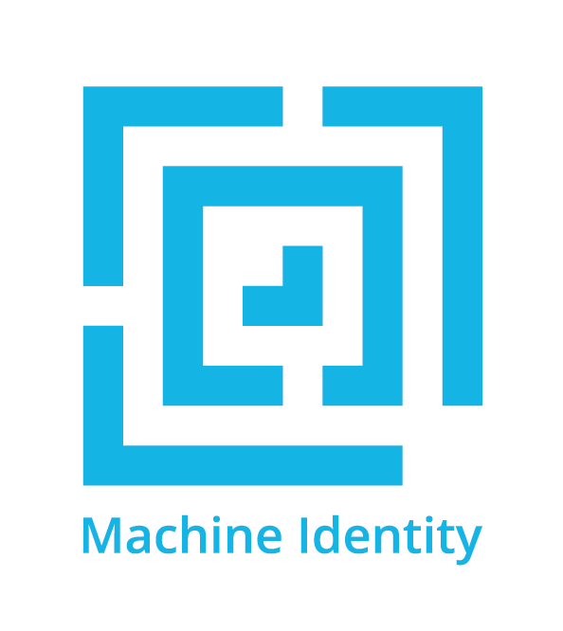

If it can be identified, Its access can be managed
Build on a chain of trust
Authenticate all requests
Authorize w/ least amount of privilege
Audit everything
...and do it with code!
The Secret-Zero Problem…
Humans have built-in authentication support:
Built-in vault for passwords
Back-channels for MFA (e.g. phones)
Non-humans need a way to bootstrap identity authentication that doesn’t put credentials at risk
But how to manage that initial secret required by apps to bootstrap identity?
Human Identity
Workload

Slide 23
Ways to establish & authenticate Identity
 | Use-Case | Means | Strengths | Weaknesses
Credential Based | Human identity | Passport, Password | Very familiar Humans have built-in vaults | Social engineering Insecure persistent storage
 | Pre-Configured Identity | API Key | Analogous to human uname/pwd model | Key distribution is subject to compromise Requestor can’t initiate
 | Bootstrapped Identity | JWT | No cached credential Works with cloud platforms & CICD tools Can provide extra control factors, e.g. TTL, multiple claims, etc. | Platform/tool dependencies
Attribute Based | Human Identity | Biometrics | Hard to spoof Convenient | Context dependent
 | Pre-Configured Identity | Various Factors | Multi-factor (selectable) OS user, path, MD5 hash, IP/Hostname | No trusted 3rd party Requires authn agent running local to applications Not scalable to container use-cases
 | Bootstrapped Identity | Trusted 3rd Party | Ideal for container orchestration | Platform dependencies Hard to implement for legacy technologies

Slide 24







IAM Role authentication in
1
Admin allowlists app identity with Conjur
Identity = app name + account # + IAM role
App gets signed header from platform service
App submits identity & signed header to Conjur
Conjur verifies header w/ platform service
Conjur issues Conjur access token to app
identity
Conjur policy
3
identity
header
5
access token
4
header
2
header

Slide 25
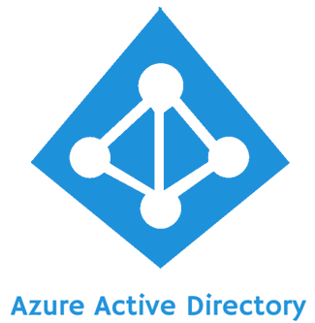
JWT authentication in
Azure AD V1 JWT:
{
"typ": "JWT",
"alg": "RS256",
"x5t": "nOo3ZDrODXEK1jKWhXslHR_KXEg",
"kid": "nOo3ZDrODXEK1jKWhXslHR_KXEg"
}.
{
…
"appid": "463be88f-d6af-4264-b3a2-048e5c3d9ea7", <-- AD-registered application UUID
…
}
1
identity
Conjur policy
Admin allowlists app identity with Conjur
Identity is a name annotated with value of JWT ‘appid’ claim:
463be88f-d6af-4264-b3a2-048e5c3d9ea7
App authenticates user w/ Azure AD, receives app-specific JWT
App submits identity & JWT to Conjur
Conjur verifies JWT w/ JWKS endpoint
Conjur issues Conjur access token to app
3
identity
jwt
5
access token
4
jwt
JWKS
2
jwt

Slide 26
Managed Identity authentication in
1
Admin allowlists app identity with Conjur
Identity is a name annotated with:
Subscription + Resource Group
Subscription + Resource Group + System-Assigned Identity
Subscription + Resource Group + User-Assigned Identity
App gets Azure access token (JWT) from IMDS
App submits identity & JWT to Conjur
Conjur verifies token w/ STS endpoint for tenant
Conjur issues Conjur access token to app
identity
Conjur policy
3
identity
jwt
5
access token
4
jwt
Metadata Service
2
jwt

Slide 27
JWT authentication in
Azure AD V1 JWT:
{
{
"alg": "RS256",
"kid": "Zx79NfQJZdTRLGiEbjiHG_9vhI_blwRGV-ZTqT5X0gk"
},
…
"sub": "system:serviceaccount:user1:app-example-authnjwt"
}
}
1
identity
Conjur policy
Admin allowlists app identity with Conjur
Identity is a name annotated with value(s) in JWT claims:
system:serviceaccount:user1:app-example-authnjwt
App gets service account JWT from pod filesystem
App submits identity & JWT to Conjur
Conjur verifies JWT w/ JWKS endpoint
Conjur issues Conjur access token to app
3
identity
jwt
5
access token
4
jwt
JWKS
/run/secrets/k8s.io/sa/token
2
jwt

Slide 28
K8s attribute authentication in
1
Admin allowlists app identity with Conjur
Two options for identity granularity:
Identity = Cluster/Namespace
Identity = Cluster/Namespace/Service Account
Authenticator client in app pod submits CSR w/ platform attributes to Conjur
Conjur verifies attributes w/ platform service
Conjur issues cert & key creds to authenticator client in app pod
Authenticator client in app pod uses creds to authenticate, get Conjur access token and shares via shared memory volume.
identity
Conjur policy
2
csr
4
5
3
verify
access token
Notes:
K8s secrets risks: https://kubernetes.io/docs/concepts/configuration/secret/#risks

Slide 29
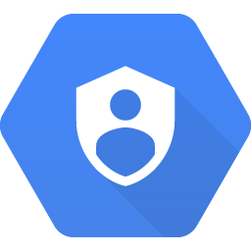
Managed Identity authentication in
1
Admin allowlists app identity with Conjur
Identity is a name annotated with:
instance-name (GCE only)
project-id (GCE only)
service-account-id
service-account-email
App gets GCP access token (JWT) from IAM service
App submits identity & JWT to Conjur
Conjur verifies token w/ IAM service
Conjur issues Conjur access token to app
identity
Conjur policy
3
identity
jwt
5
access token
4
jwt
2
Cloud IAM
jwt

Slide 30
K8s Application Options with Conjur
Attribute-Based Authentication (authn-k8s)
App retrieves secrets
Authenticator runs as a sidecar or init container
App pulls secrets with REST API (or Summon)
K8s secrets
K8s Secrets Provider runs as an init container or job
Manifest for K8s secrets contain Conjur maps
Provider parses Conjur map, retrieves secrets & dynamically patches K8s secrets w/ secret values
Secrets pushed to file
K8s Secrets Provider runs as an init container or sidecar
Manifest for pod contains annotations w/ Conjur map and file format specs
Provider parses annotations, retrieves secrets & writes secrets to pod’s filesystem in specified format
Secretless
Secretless Broker runs as a sidecar listening on pod port(s)
App attempts connection on local port
Broker retrieves secrets, proxies connection for app
JWT Authentication (authn-jwt)
App retrieves secrets
App authenticates with service account JWT
App pulls secrets with REST API (or Summon)

Slide 31



Summon for Secrets Injection
1
2
Summon invoked with authenticated identity
1
2
Summon fetches secrets using identity
3
3
Processes launched with secrets in environment
Learn more at: https://cyberark.github.io/summon/

Slide 32
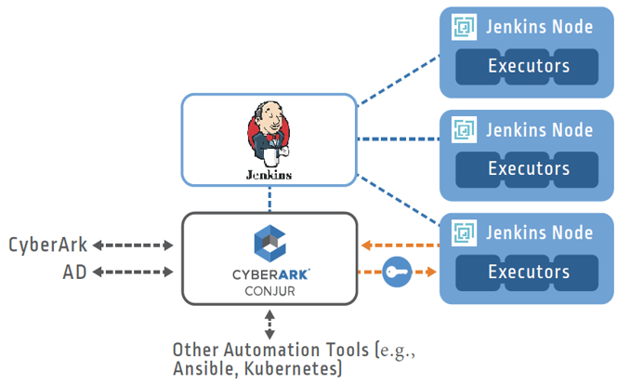

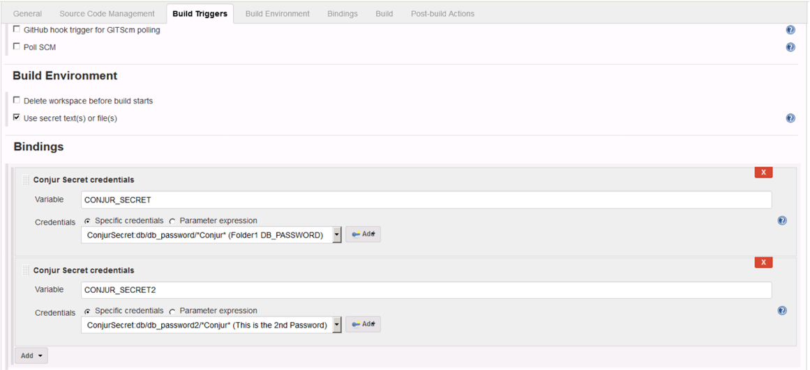

Orchestrating the Pipeline
Utilize recommended best practices with jenkins
Use Jenkins Pipelines to your advantage
Ephemeral Jenkins Slaves (Executors) via Docker
Utilize Kubernetes or OpenShift as much as possible
This allows for attribute-based authentication, no secret zero!
Establish Machine Identity on Ephemeral Nodes
Use Credentials Plugin for Secure Secrets Delivery
Notes:
Go in-depth with Conjur vs. AIM and why.why not

Slide 33
Credential Providers

Slide 34



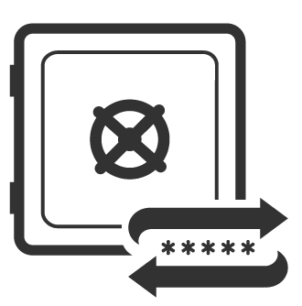




Credential Provider
High performance and availability
SDK
Application
Credential Provider
CyberArk Vault
Application Server
Username = GetUserName()
Password = GetPassword()
Host = GetHost()
ConnectDatabase(Host, Username, Password)
In case a network outage should occur, credentials will always be available from the secure local cache
Target System

Slide 35

Central Credential Provider
Centralized, agentless approach
HTTPS
Application
Username = GetUserName()
Password = GetPassword()
Host = GetHost()
ConnectDatabase(Host, Username, Password)
Central Credential Provider
Agentless, web service-based application secrets management solution
Eliminates risk from hard-coded application credentials
Platform agnostic
Alleviates deployment overhead
Target System
CyberArk Vault

Slide 36
Securing Admin Scripts with PSM & Credential Provider
Script identities can be unique, w/ access to different safes. Script editing can be prevented using hash authentication.
Admin access is authenticated and recorded
CyberArk Vault
Databases
Servers
Network Equipment
scriptA
CLI
CP
scriptB
CLI
Admins
PSM
Secure Script Server
Target Systems

Slide 37
Securing Admin Scripts with PSM & Central Credential Provider
CP
Admin access is authenticated and recorded
CyberArk Vault
Script identities can be unique, w/ access to different safes.
Databases
Servers
Network Equipment
scriptA
REST
scriptB
REST
Admins
PSM
Secure Script Server
Target Systems

Slide 38
Powershell script authentication with CCP
$AppID = "App_MyApp"
$object = ”epv-account-id"
$CCPAddress = "https://CyberArkCCP/WindowsAuthentication/api/Accounts?AppID=$AppID&Object=$object"
$restresponse = ""
$restresponse = invoke-restmethod -uri $CCPAddress -method GET -UseDefaultCredentials
Windows HTTP client stack provides AD domain credentials w/o including them in the script
Transparent NTLM authentication
http://patelshailesh.com/index.php/how-windows-authentication-works-with-iis-http-sys-kerberos-ntlm
CCP’s IIS server authenticates credentials with AD
Also supported from Java and C# apps:
https://stackoverflow.com/questions/54568189/how-to-provide-ntlm-authentication-while-calling-any-url
https://docs.microsoft.com/en-us/dotnet/api/system.net.webclient.usedefaultcredentials?view=net-5.0

Slide 40
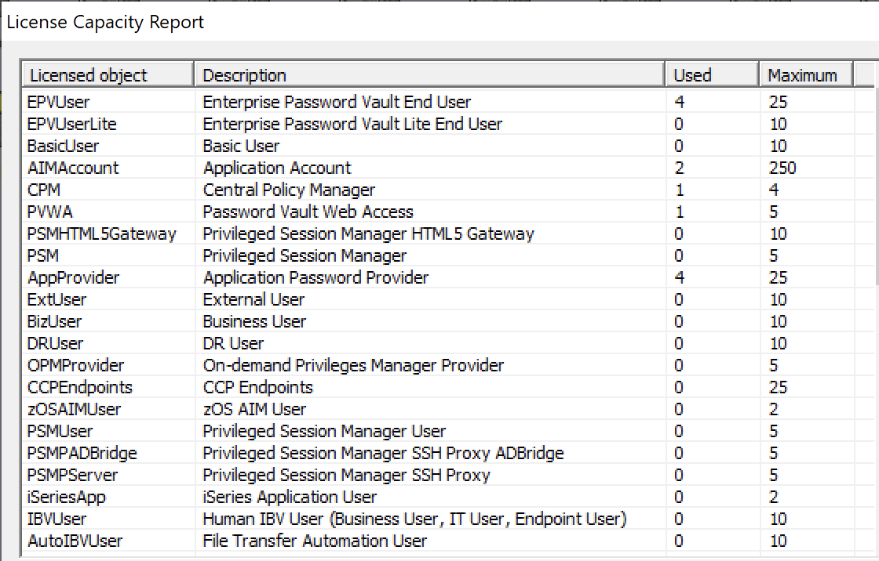
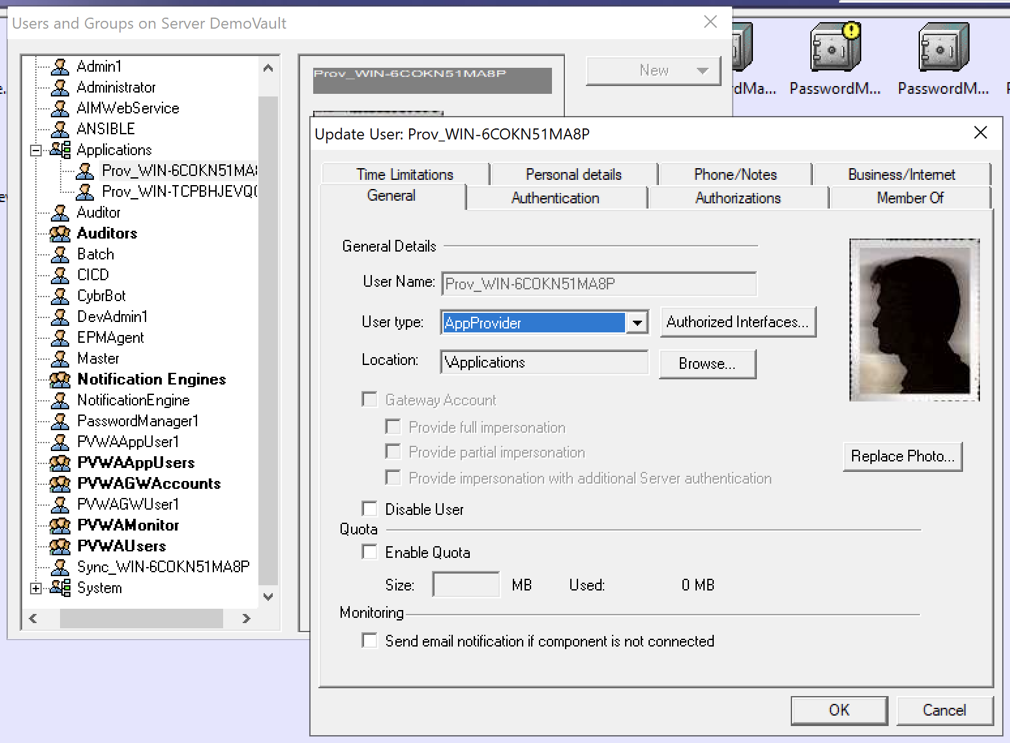
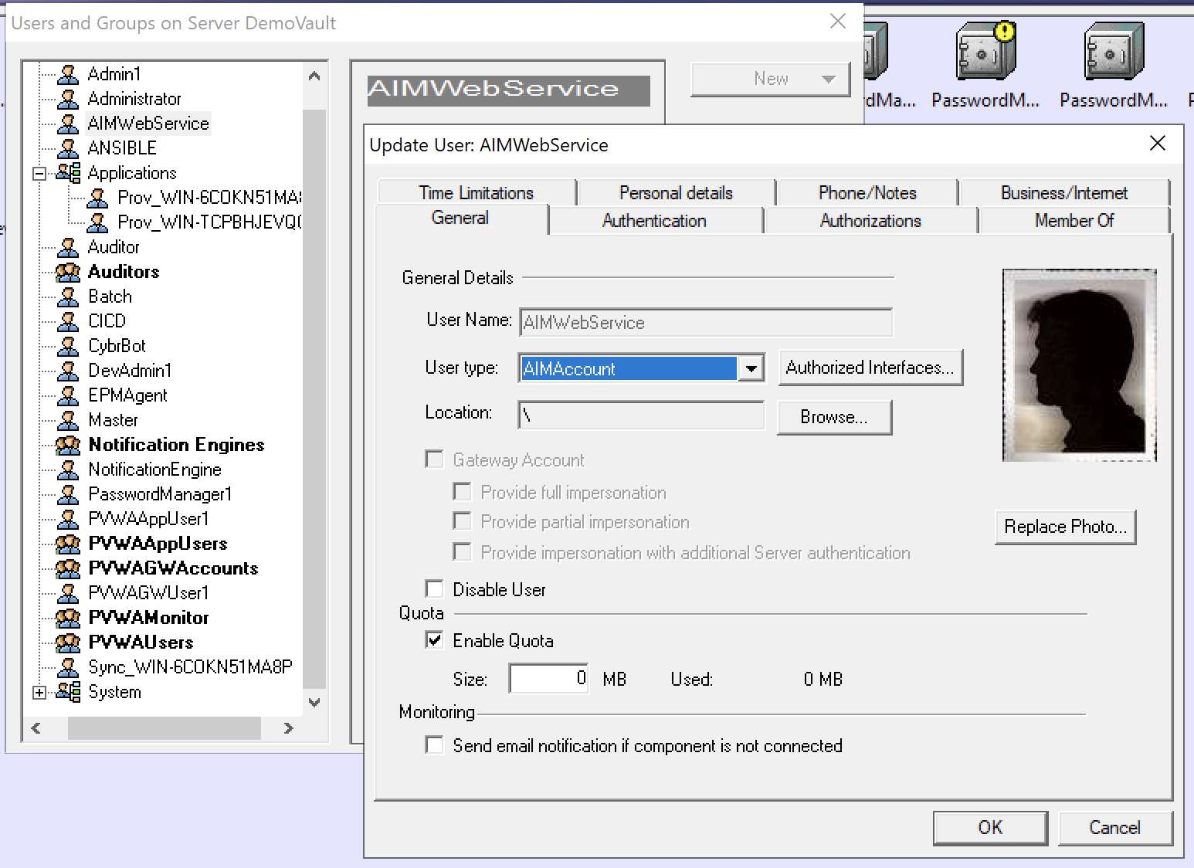
CyberArk Secrets Management CP Solution Licensing
AppProvider
AppProvider
AppProvider
Agent-Based
Agentless
CCPEndpoint
443
app
SDK
app
CyberArk
Vault
REST
CP
AIMAccount
CP
AIMAccount
1858
script
script
CLI
REST
Credential Provider
Central Credential Provider
AIMAccount
AIMAccount
AIMAccount
CP/CCP/ASCP Licensing Terminology
Represented in License Capacity Report:
AppProvider == Credential Provider agent
Licensed: APP_STATIC_xxx, APP_ISV_xxx, APP_RPA_xxx SKUs
Unlicensed (no $$): Sync/LOB users
Tracked & enforced by license manager
AIMAccount == Application ID (AppID) in PVWA
Not licensed (no $$), provided as ~10x AppProvider count
More can be allocated w/ support ticket
Tracked & enforced by license manager
CCPEndpoints == Calling system hosting apps calling CCP
Licensed: APP_STATIC_xxx, APP_ISV_xxx, APP_RPA_xxx SKUs
Not tracked or enforced by license manager
Licensing Terminology:
Calling System == a host/IP-address calling CP/ASCP/CCP
Primarily used for licensing custom/in-house built applications
Not represented directly in License Capacity Report
APP_STATIC_xxx SKU
Map to CP/ASCP AppProviders + CCPEndpoints
Third-party/ISV/RPA license units are product-specific
Robotic Process Automation (RPA) Solutions
APP_RPA_xxx SKU
Licensed per bot
Non-RPA solutions
APP_ISV_xxx SKU
Examples:
Vulnerability scanners -> licensed per scanning engine
ServiceNow -> licensed per mid server
Config
Files
J2EE App Server
CP
DS
app
Application Server Credential Provider
CPM Push-to-File
Conjur Enterprise
Calling System
Calling System
Calling System

Slide 41

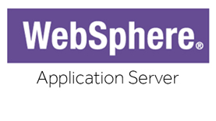



Application Server Credential Provider
DATA SOURCE
REFERENCE
API CALL
Client Application
Application Server
ASCP
DataSource customerDataSource = (DataSource)
context.lookup("java:comp/env/jdbc/customer_db")
Local secure caching
High-availability
Enhanced auth & anti-tampering
J2EE App Sever
Minimal code changes
Username = GetUserName()
Password = GetPassword()
Datasource
CyberArk Vault

Slide 42
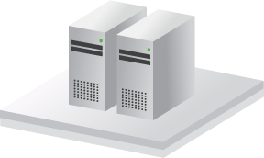




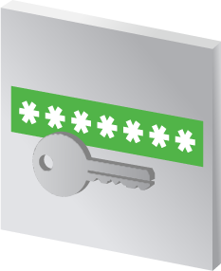






Traditional Application Access: High level perspective
Application Identity Management
Applications
Application Servers (WebSphere, Weblogic, etc.)
Secure Storage
Databases
Security Appliances
*****
Applications
Unix Servers
CyberArk Vault
Password and SSH Key Rotation
Network Devices
Servers
Applications
Windows Servers
Username = GetUserName()
Password = GetPassword()
Host = GetHost()
ConnectDatabase(Host, Username, Password)
Username =
Password =
Host =
ConnectDatabase(Host, Username, Password)
“app”
“y7qeF$1”
“10.10.3.56”
Websites/ Web Apps
Cloud Infrastructure
Applications
Mainframe Servers
Applications
Desktops
Notes:
Applications can reside anywhere in an organization, be it servers or desktops. Unix Servers, Windows Servers, Mainframes, Application servers, such as WebSphere, Weblogic, etc.
<CLICK 1>
Typically, these applications will need to connect to a remote resource, such databases, web application, cloud infrastructure, and even simply other servers.
In order to connect and communicate with these resources, the application must use credentials, and as we saw earlier these credentials are naturally hard-coded into the application code, which expose them to attackers and insider threats.
<CLICK 2>
Moreover, these credentials are almost never changed, because they have been hard-coded into tons of applications throughout the organization.
How does CyberArk overcome these challenges?
First thing’s first – remove the hard-coded credential from the application code.
CyberArk Application Identity Manager enables the complete elimination of hard-coded and embedded credentials in applications by replacing them with SDKs. The credential are stored in Vault, and are retrieved using the SDK inside the application code.
Credentials, be it password or SSH keys, can then be easily rotated based on the organization policy and the application will transparently use these new credentials whenever required,
Let’s have a look at how this works.
Attackers or malicious insiders will eventually get access to these credentials, so what we need to do is store them in the Vault
<CLICK 3>
This will secure them and enable their frequent rotation
Then, we must get rid of these hard-coded credentials <CLICK 4> and replace them with SDK calls
<CLICK 5>
This will enable applications to retrieve the credentials stored and secured in the Vault
<CLICK 6> When a credential is required by an application it is retrieved from the Vault to the application, and then used to authenticate to whichever resource it is required.
And this summarized the high-level concept of AIM – Application Identity Manager.
Let’s now go on and discuss all of AIM’s benefits
<CLICK 7>

Slide 43



But why change code? J2EE
Integration with Java Application Servers enables the transparent management of datasource credentials for: WebSphere, WebLogic, JBoss, Tomcat
Requires no code changes to the J2EE application. One-time configuration change to the application server.
Server
WebSphere
J2EE
Application
Database
Application Server Credential Provider
CyberArk Vault
Notes:
The third solution included in AIM, is a solution for Java Application Servers.
This is a solution for the transparent management of datasource credentials, the credentials used by the application servers to connect to databases and other assets at the heart of the enterprise.
<CLICK 1>
Among the SDKs CyberArk AIM offers is a Java SDK, through which Java applications can retrieve credentials, as we have seen in the previous slides.
But why change the code of all application when you can make a one time configuration change in the Application Server itself?
CyberArk has developed and patentized an innovative solution that eliminates hard-coded credentials in Java Applications servers without needing to change a single line of code, which as we know, can be a big challenge to orchestrate.
<CLICK 2>
The Application Server Credential Provider is installed on the Java Application Server, just like the Credential Provider we saw in the previous slides.
<CLICK 3>
Similar to the Credential Provider, everytime the Java application requires a credential, it is retrieved from the Vault, stored in the cache, and the connection is established by the Java Application Server.
The credential never makes it to the application itself.
The Application Server Credential Provider is very popular for the beginning of AIM projects, since it requires no code changes, and is very easy to implement.

Slide 44

But why change code? J2EE
Integration with Java Application Servers enables the transparent management of datasource credentials for: WebSphere, WebLogic, JBoss, Tomcat
Requires no code changes to the J2EE application. One-time configuration change to the application server.
Server
WebSphere
J2EE
Application
Database
Application Server Credential Provider
CyberArk Vault
Notes:
The third solution included in AIM, is a solution for Java Application Servers.
This is a solution for the transparent management of datasource credentials, the credentials used by the application servers to connect to databases and other assets at the heart of the enterprise.
<CLICK 1>
Among the SDKs CyberArk AIM offers is a Java SDK, through which Java applications can retrieve credentials, as we have seen in the previous slides.
But why change the code of all application when you can make a one time configuration change in the Application Server itself?
CyberArk has developed and patentized an innovative solution that eliminates hard-coded credentials in Java Applications servers without needing to change a single line of code, which as we know, can be a big challenge to orchestrate.
<CLICK 2>
The Application Server Credential Provider is installed on the Java Application Server, just like the Credential Provider we saw in the previous slides.
<CLICK 3>
Similar to the Credential Provider, everytime the Java application requires a credential, it is retrieved from the Vault, stored in the cache, and the connection is established by the Java Application Server.
The credential never makes it to the application itself.
The Application Server Credential Provider is very popular for the beginning of AIM projects, since it requires no code changes, and is very easy to implement.

Slide 45
Password Change Management

Slide 46
Password change management w/ dual accounts
Initial State
Rotation 1
Synchronization
Rotation 2
Enterprise Password Vault
Active:
Inactive:
CPM Interval
Enterprise Password Vault
Inactive:
Active:
Sync Interval
Enterprise Password Vault
Inactive:
Active:
Grace Period
Enterprise Password Vault
Inactive:
Active:
acct1
acct1
acct1
acct1’
acct2
acct2
acct2
acct2
Synchronizer
Synchronizer
Primary
Primary
Primary
Primary
acct1
acct1
acct2
acct2
Follower
Follower
Follower
Follower
acct1
acct1
acct2
acct2
App A
App A
App A
App B
App C
App B
acct1
acct1
acct1
acct2
acct2
acct2
DB
DB
DB
DB
acct1
acct2
acct1
acct2
acct1
acct2
acct1’
acct2

Slide 47
Marketplace Integrations (C3 Alliances)

Slide 48
RPA: Integration Overview & Benefits
Challenges without CyberArk CCP integration
Sensitive data stored in two places:
CyberArk EPV & RPA Credential Vault
Extra effort in maintaining data security at two places.
User access to copy/paste sensitive data from CyberArk to RPA solution
Sensitive credentials exposed to multiple users
Benefits of CCP integration
Credentials securely stored in CyberArk EPV
CyberArk manages access to & automatically rotates credentials
No User access - credentials only accessible to authentication bots
Credentials securely retrieved as needed for robots to perform their functions
All access captured in audit logs
Client stays in compliance with corporate policies and industry guidelines
Integration implemented and supported by vendors

Slide 49
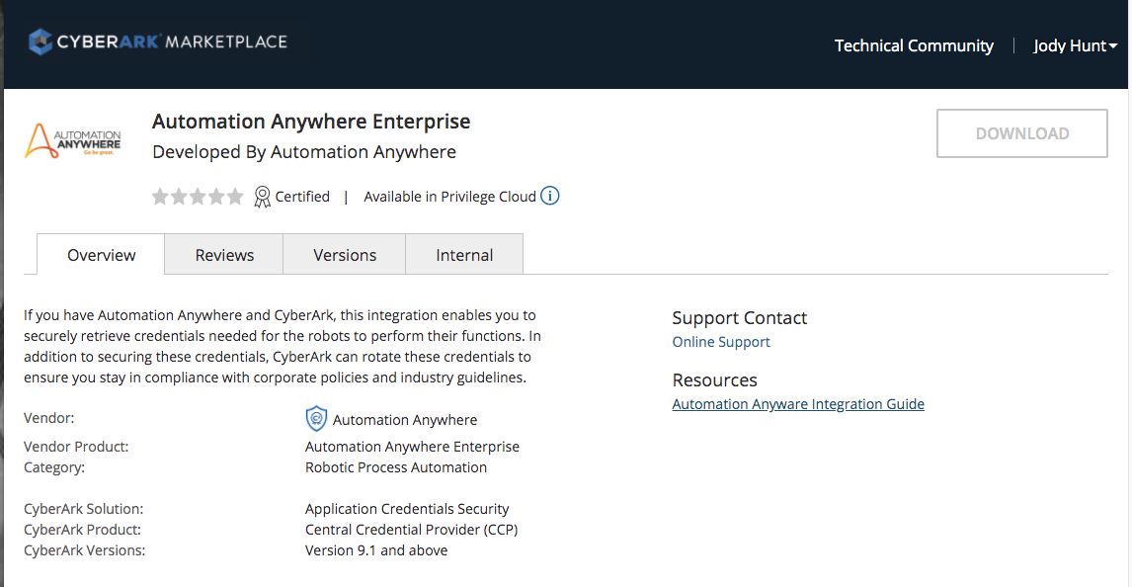
Automation Anywhere: Integration offered in CyberArk Marketplace

Slide 50
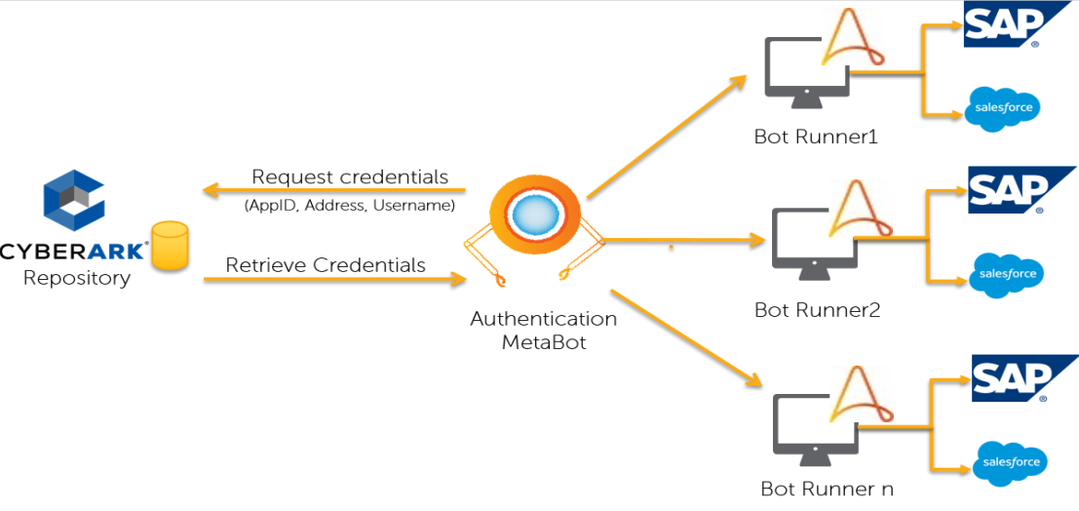
Automation Anywhere: Solution architecture with CyberArk CCP

Slide 51
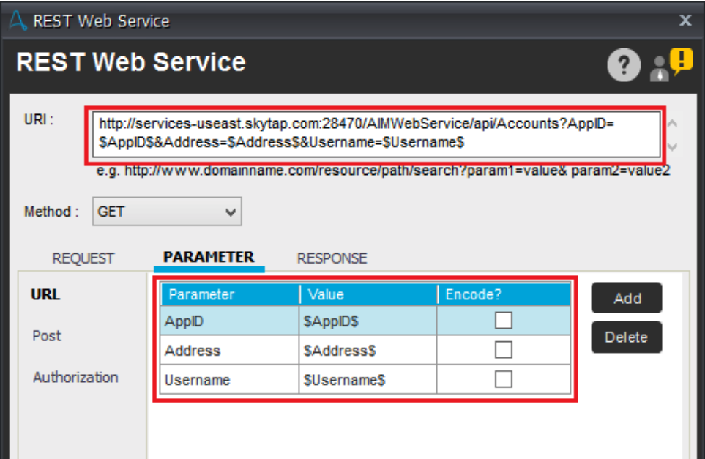
Automation Anywhere: Configuring Metabot connection to CCP

Slide 52
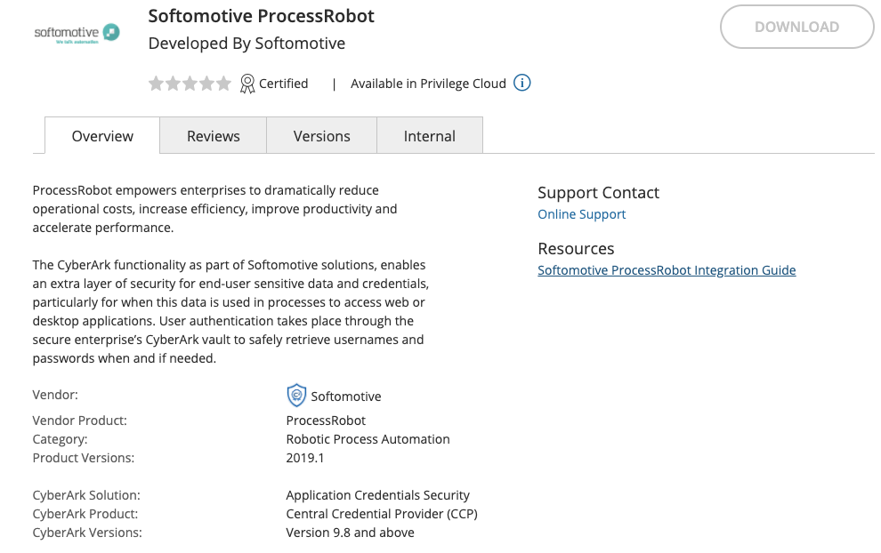
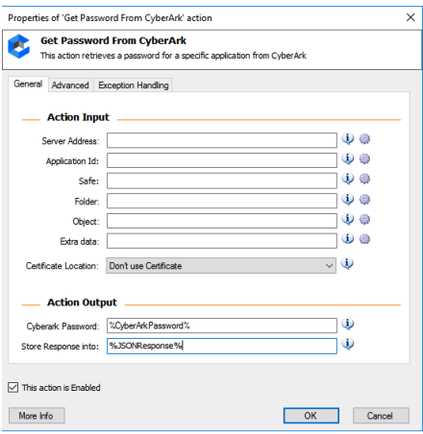
Microsoft Power Automate
Formerly softomotive
Benefits of CCP integration
Credentials securely stored in CyberArk EPV
CyberArk manages access to & automatically rotates credentials
No User access - credentials only accessible to authentication bots
Credentials securely retrieved as needed for robots to perform their functions
All access captured in audit logs
Client stays in compliance with corporate policies and industry guidelines

Slide 53
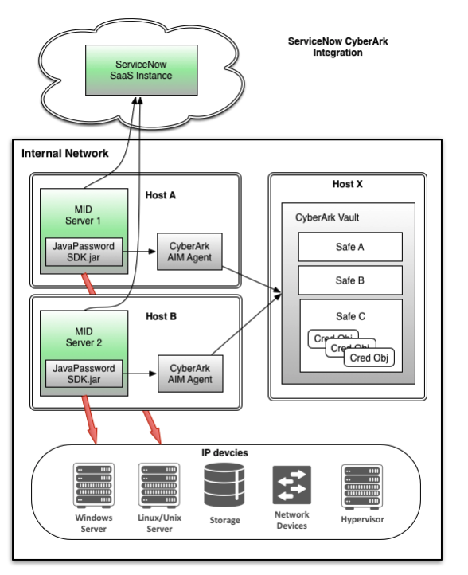
ServiceNow
Challenges without CyberArk CP integration
Sensitive data stored in two places:
CyberArk EPV & ServiceNow Instance
Extra effort in maintaining data security at two places.
User access to copy/paste sensitive data from CyberArk to ServiceNow console
Sensitive data exposed to multiple users
Benefits of CP integration
Enables Orchestration, Discovery, and Service Mapping to run without storing any credentials on the instance
Credentials securely stored in CyberArk EPV
CyberArk manages access to & automatically rotates credentials
No User access - credentials only accessible to MID Servers
Credentials securely retrieved as needed to perform functions
All access captured in audit logs
Client stays in compliance with corporate policies and industry guidelines
Integration implemented and supported by ServiceNow

